Slide 1
The Impact of Rising Interest Rates on Real Estate Values
James D. Shilling
DePaul University
September 17, 2015
James D. Shilling
The Impact of Rising Interest Rates on Real Estate Values

Slide 2
The Big Picture
Background on Current Interest Rate Policy
Raising Rates will Impact Everyone
Big picture for real estate investors
The ideas
A significant monetary tightening shock will cause a decline in real estate prices as a result of a negative demand shock.
Dollar will strengthen and net exports will decline.
Aggregate demand will decline (contractionary policy).
Real estate values will fall as rental growth declines (definition).
The valuation effects should not be very large, at least at first (i.e., rates are not going to double or triple overnight).
Global savings and investment flows may partially offset any decline in value.
Supporting shocks include a decline in risk aversion (presumably driven by a drop in the risk of a major crisis) and positive demand shocks.
James D. Shilling
The Impact of Rising Interest Rates on Real Estate Values

Slide 3
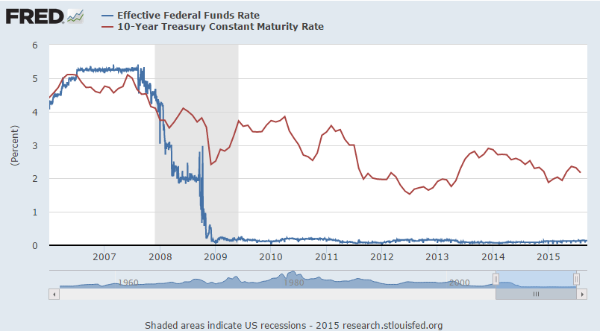
The Big Picture
Background on Current Interest Rate Policy
Raising Rates will Impact Everyone
The Federal Reserve has been holding interest rates near zero since late 2008
James D. Shilling
The Impact of Rising Interest Rates on Real Estate Values

Slide 4
The Big Picture
Background on Current Interest Rate Policy
Raising Rates will Impact Everyone
The Fed’s policy will impact everyone!
The ideas
Raising rates will negatively impact those who have a credit card, car loan, and a private student loan.
Higher rates will positively affect those who have money in a savings account (e.g., retirees living on fixed income).
A mortgage interest rate hike will worsen housing affordability for first-time buyers.
Equity prices should decline while real bond yields should rise.
James D. Shilling
The Impact of Rising Interest Rates on Real Estate Values

Slide 5
Effects on Individual Markets
Words and Numbers
All property markets are recovering as predicted last year . . .
Source: Moody's/RCA CPPI - Composite Indices.
James D. Shilling
The Impact of Rising Interest Rates on Real Estate Values

Slide 6
Effects on Individual Markets
Words and Numbers
Apartments …
Words
David Neithercut, CEO, Equity Residential, Oct. 2013
  There are 4 million people turning 21-years old every year in this country … there will be 1.3 to 1.4 million households being formed every year and institutional grade, core multi-family [rental housing] will attract a significant percentage of them.
    Millions of renters under the age of 35 are choosing to live in the city and can only afford to rent. They’re getting married later in life and moving to the suburbs later as well. Demographics is the key to why the number of adults who choose to rent a residence will continue to grow.
Two supporting shocks
  For those whose monthly income is already heavily sliced with student loans, the debt burden is only going to get worse with higher rates (a positive demand shock for apartments).
  A rapid rise in mortgage interest rates will negatively affect affordability for owner-occupied housing through higher monthly mortgage payments (a positive demand shock for apartments).
James D. Shilling
The Impact of Rising Interest Rates on Real Estate Values

Slide 7
Effects on Individual Markets
Words and Numbers
Office …
Words
Mitt Romney, May 4, 2012 in an interview on Fox & Friends
  We should be seeing numbers in the 500,000 jobs created per month.
  Labor market is actually creating 215k jobs per month, the unemployment rate is staying at 5.3%, wage growth is at 0.2%, and the participation rate remains at a multi-decade low of 62.6%. Labor markets are trending toward a tipping point.
  This job growth has been a key factor for filling CBD office buildings. Have seen a rise in corporate relocations to cities from the suburbs as a strategy to attract younger, urban professionals.
A negative shock
  Financial firms are vulnerable to changes in interest rates (a negative demand shock for office buildings), but financial firms are no longer a big driver of office demand. A supporting shock has been (and will continue to be) the presence of tech firms and media companies (the so-called TAMI industries).
James D. Shilling
The Impact of Rising Interest Rates on Real Estate Values

Slide 8
Effects on Individual Markets
Words and Numbers
Office …
What is going on here?
Steven Roth, Chairman, Vornado Realty Trust, June 9, 2015
  The easy money has been made at this point. This is the time when the smart guys are starting to build cash. I’ve had a handful of very, very smart guys jump on top of that comment and say they agreed with me. And so that’s why we do acquisitions very carefully at this point in the cycle.
  Vornado Realty Trust is a New York based real estate investment trust. Vornado owns office and retail spaces throughout New York City, Washington, D.C. and Chicago. Vornado is the owner of the Merchandise Mart.
James D. Shilling
The Impact of Rising Interest Rates on Real Estate Values

Slide 9
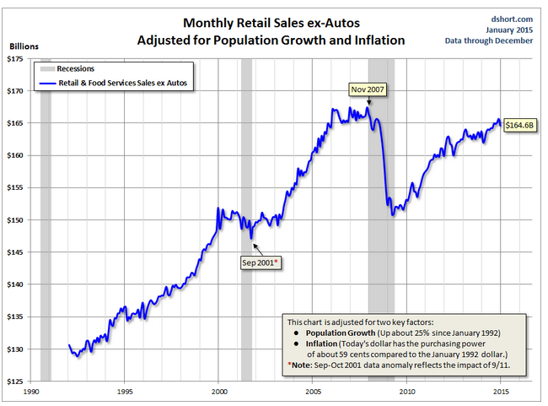
Effects on Individual Markets
Words and Numbers
Retail …
Source: Census Bureau.
Retail sector faces continued challenges. Consumer sales remain below the level we saw at the peak before the last recession. Puzzling? Driving factor could be uncertainty about future income.
James D. Shilling
The Impact of Rising Interest Rates on Real Estate Values

Slide 10
Effects on Individual Markets
Words and Numbers
Industrial …
Words
Counselors of Real Estate, 2015-16 Top Issue Affecting U.S. Real Estate
  Large number of retiring Baby Boomers and the Millennials will have the greatest impact on real estate through the lifestyles they choose in the coming years.
  The real estate and service sectors targeting each group are adapting – medical facilities, retail, office, and entertainment venues, as well as infrastructure and distribution facilities.
A supporting shock
  A positive aggregate supply shock from lower oil prices is good news for consumers and the US economy. However, prices are falling partly because of worries about a global economic slowdown. It is conceivable that bad news from China could trigger a rise in risk aversion.
James D. Shilling
The Impact of Rising Interest Rates on Real Estate Values

Slide 11
Effects on Individual Markets
Words and Numbers
Housing markets . . .
Words
Christina Romer, December 5, 2011
  Normally, residential investment is a big source of the surge in demand and growth coming out of a recession. That is true because normally recessions result from tight monetary policy, which raises interest rates and crunches housing. But the recent recession obviously didn’t follow this usual pattern.
  Of course, we will eventually need to build more houses. Population growth and general recovery will gradually work off the excess inventory, and construction will pick up again. But I fear that day is still a long way off. As a result, we will be missing a key source of demand for the foreseeable future.
A negative shock (see Hendershott, Lee, and Shilling, Wall Street Journal, February 26, 2014)
  As interest rates begin to rise from their record lows of the past two years, more homeowners with a 3.5% rate will find it less appealing to sell their home when faced with buying their next one at, say, a 5.5% or 6% rate. Millions of homeowners could face so-called “lock in” from low interest rates, especially if rates rise sharply in the coming years, potentially curbing housing demand.
James D. Shilling
The Impact of Rising Interest Rates on Real Estate Values

Slide 12
Effects on Individual Markets
Words and Numbers
Most likely inference . . .
Source: Preqin.
Markets will be buoyed in part by strong global capital flows.
James D. Shilling
The Impact of Rising Interest Rates on Real Estate Values

